Slide 1




kki
NEXT GEN EMPLOYABILITY PROGRAM
Creating a future-ready workforce
Team Members
College Name
Student Name praveena .E :
Student ID :511321104071

Slide 2

CAPSTONE PROJECT SHOWCASE
Project Title
Building Bus Reservation System using Python and Django
Abstract | Problem Statement | Project Overview | Proposed Solution | Technology Used | Modelling & Results | Conclusion

Slide 3
Abstract
1. Backend Efficiency: Django's MVT architecture ensures smooth backend development, maintaining data consistency across entities.
2.Interactive Frontend: With HTML, CSS, JavaScript, and Django's templating engine, users experience dynamic interactions without page reloads.
3. Secure User Management: Built-in authentication ensures secure user registration, login, and booking management, while admins control backend functionalities securely.
4. Scalability and Deployment: Leveraging Django's ecosystem and best practices, the project ensures scalability and reliability, deploying seamlessly on platforms like Heroku or AWS.
Source :

Slide 4
Problem Statement
Problem Statement Developing a bus reservation system using Django for full stack development,
aiming to create an efficient and user-friendly platform for booking bus tickets while ensuring secure management of routes, schedules, and user data.
Source :

Slide 5
Project Overview
Overview:
The project entails building a comprehensive bus reservation system using Django for full stack development
. It involves creating an intuitive web interface for users to book bus tickets seamlessly
. Administrators will have access to manage routes, schedules, and user information securely
. The system will prioritize user experience, security, and efficient management functionalities.
Source :

Slide 6
Proposed Solution
.
Proposed Solution:
The solution involves developing a bus reservation system using Django, encompassing both frontend and backend components. The frontend will feature a user-friendly interface built with HTML, CSS, and JavaScript, ensuring seamless navigation and booking experience. AJAX techniques will be employed for real-time updates without page reloads.
The backend will leverage Django's MVT architecture to organize data models for buses, routes, schedules, and bookings. Authentication and authorization will be implemented using Django's built-in features to ensure secure access control.
Additionally, integration with third-party payment gateways will enable secure transactions. The system will be scalable, deploying on platforms like Heroku or AWS, with continuous integration and deployment pipelines for streamlined development workflow. Overall, the proposed solution aims to deliver a robust, secure, and user-friendly bus reservation system tailored to meet the project's objectives.
Source :

Slide 7
The proposed solution for the bus reservation system involves utilizing Django for full stack development, prioritizing scalability, security, and user experience. The frontend will be developed using modern web technologies like React.js or Vue.js, ensuring a responsive and interactive user interface.
For the backend, Django's MVT architecture will be utilized to structure the application's logic efficiently. Data models will be created for buses, routes, schedules, and bookings, ensuring data integrity and seamless interactions.
Source :

Slide 8
Authentication and authorization will be implemented using Django's authentication system, bolstered by JWT (JSON Web Tokens) for secure user sessions. Additionally, HTTPS encryption will be enforced to protect sensitive data during transmission.
The system will integrate with reputable payment gateways like Stripe or PayPal for secure online transactions. Deployment will be handled using Docker containers, allowing for easy scaling and portability across different environments.
Continuous integration and deployment pipelines, coupled with automated testing, will ensure code quality and reliability throughout the development process. Overall, this solution aims to deliver a robust, scalable, and secure bus reservation system that meets the needs of both users and administrators effectively.
Source :

Slide 9


Technology Used
Front-end
Back-end
Source :

Slide 10
Modelling & Results
Model:Data Model: Booking
- Fields:
- id: Primary key for the booking.
- user: Foreign key linking to the user who made the booking.
- bus: Foreign key linking to the bus reserved.
- schedule: Foreign key linking to the schedule of the booking.
- seat_number: Field indicating the seat number booked.
- booking_time: Timestamp indicating when the booking was made.
Result: Secure Booking Management**
- Users can seamlessly book bus tickets by selecting available seats.
- Each booking is securely stored in the database with associated user, bus, schedule, and seat information.
- Administrators can manage bookings, view details, and handle any necessary modifications or cancellations securely.
- Booking data is maintained securely, ensuring data integrity and confidentiality.
Source :

Slide 11
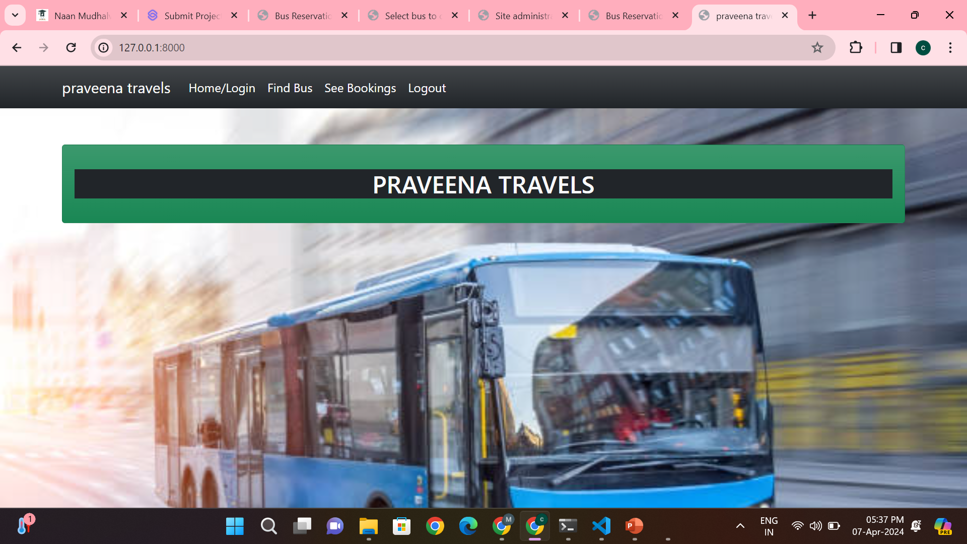
Homepage

Slide 12
About-Us-Page

Slide 13
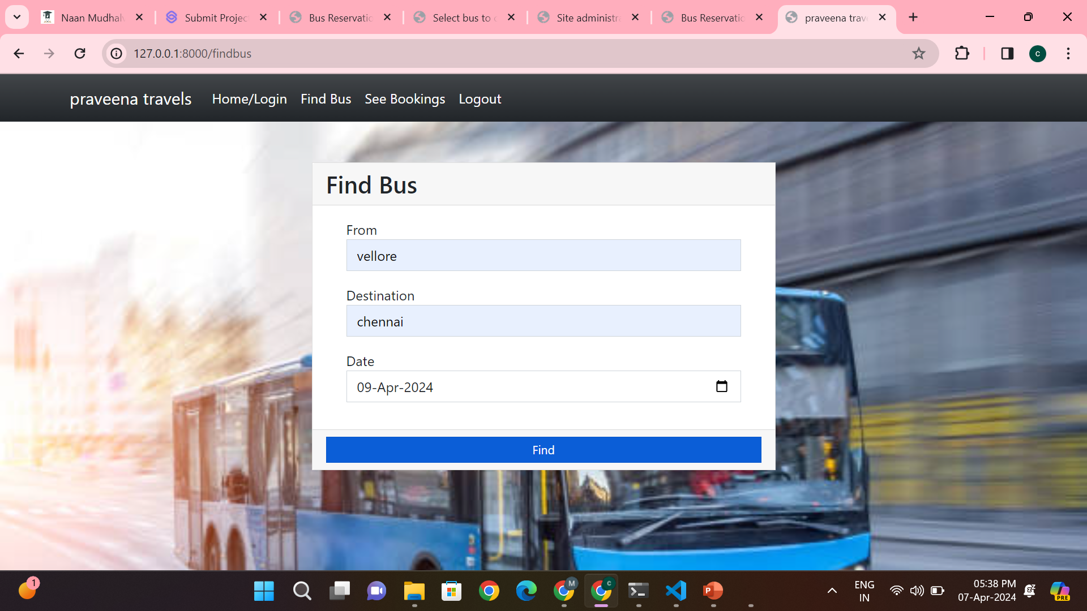
Service-Page

Slide 14
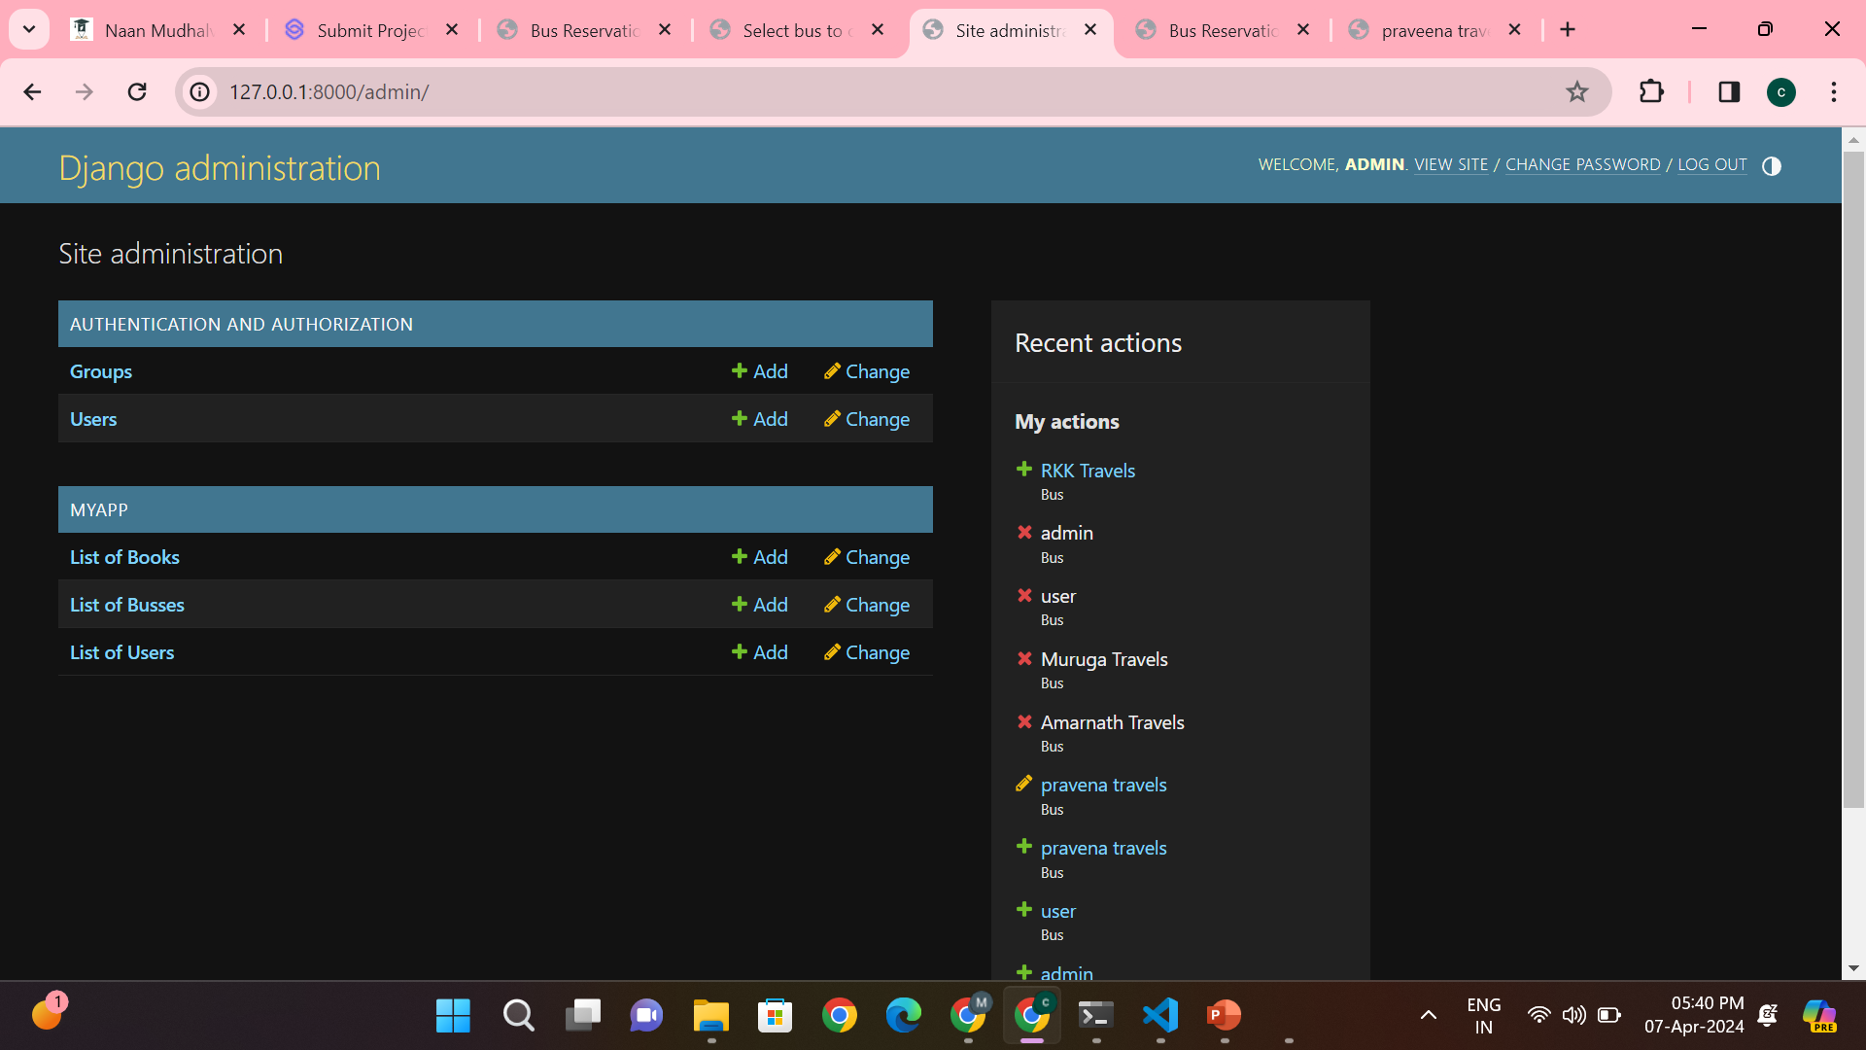
Departments-Page

Slide 15
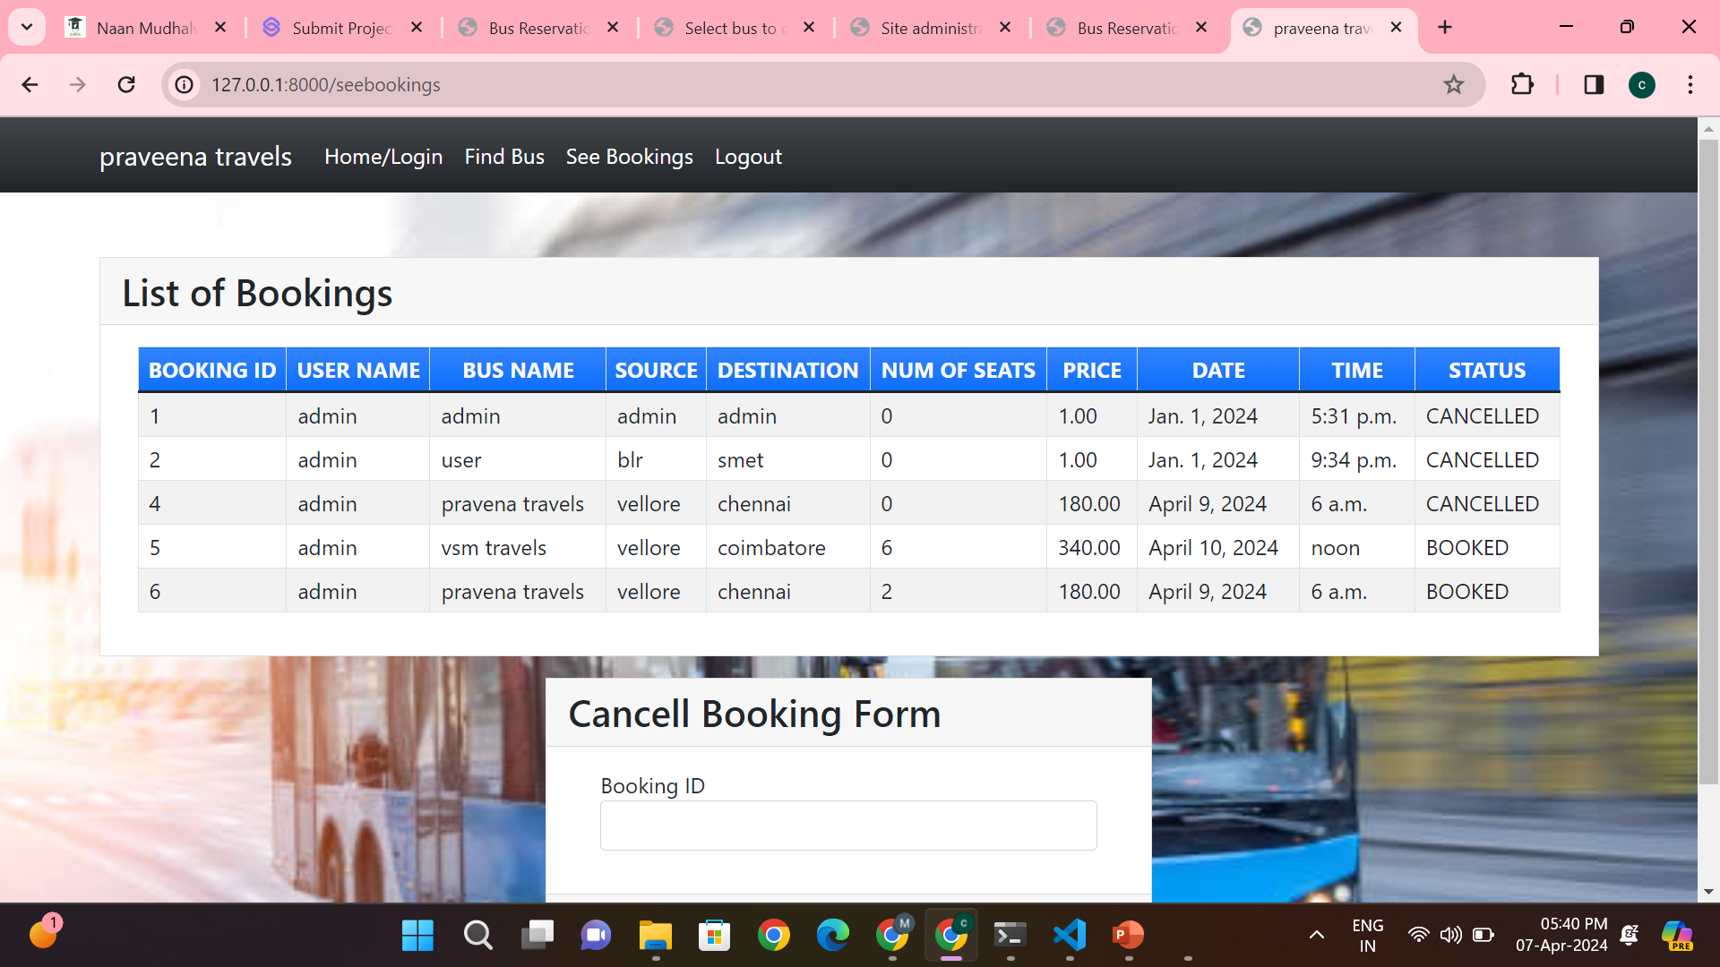
Blog-Page

Slide 16
Future Enhancements:
Enhance your Django-based bus reservation project with intuitive UI upgrades, advanced search options, and payment gateway integration. Real-time updates, a refined admin panel, and social authentication streamline user experience. Boost accessibility with multi-language support and native mobile apps. Optimize performance and security while integrating external APIs for added functionality. Incorporate feedback systems for user reviews, fostering a comprehensive travel solution.

Slide 17
Conclusion
In conclusion, by implementing these enhancements, your Django-based bus reservation project can offer users a seamless and efficient booking experience. With intuitive UI upgrades, advanced search options, and real-time updates, users can easily find and book buses. Payment gateway integration ensures secure transactions, while multi-language support and native mobile apps enhance accessibility. Optimizing performance and security, along with integrating external APIs, enriches functionality. Incorporating feedback systems fosters user engagement, ultimately creating a comprehensive and user-friendly travel solution.
Source :

Slide 18
Thank You!
Notes:
Thank You !!

